Slide 1
OCTAVE APPROACH

Slide 2
What is OCTAVE
Operationally Critical Threat, Asset, and Vulnerability Evaluation is a suite of tools, techniques, and methods for risk based information security strategic assessment and planning.
The OCTAVE approach was developed by the Software Engineering Institute (SEI) at Carnegie Mellon University in 2001 to address the information security compliance challenges faced by the US Government Departments.

Slide 3
..contd
The OCTAVE approach is a framework that enables organizations to understand, assess and address their information security risks from the organization's perspective
OCTAVE is not a product, rather it is a process-driven methodology to identify, prioritize and manage information security risks
OCTAVE is self directed, people from an organization assume responsibility for setting the organization’s security strategy.

Slide 4
..contd
Unlike typical technology focused assessment, which is targeted at technological risk and focus mainly on technical security issues, OCTAVE is focused on strategic and practical issues faced by the organization which encompass quite a lot more than technology.
BUSINESS
IT

Slide 5
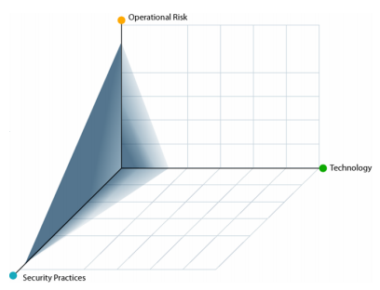
Organizational Needs
So in Octave Business and IT work together to address the security needs of an organization balancing the three aspects of Operational Risk, Security Practices, and technology

Slide 6
Benefits of OCTAVE
Operational Risks and Security Practices drive OCTAVE
Technology is examined only in relation to security practices in order to further refine them
OCTAVE helps in making information protection decisions based on risks to CIA
All aspects of risk (A,T,V,BI) are accounted for in decision making enabling an organization to match a practical protection strategy to its security risks
OCTAVE | Traditional Approaches
Organizational Evaluation | System Evaluation
Focus on Security Practices | Focus on Technology
Strategic Issues | Departmental Issues
Self Direction | Expert Led

Slide 7
..contd
OCTAVE is intended to help organizations
Develop Risk Evaluation criteria based on Business Needs
Identify assets that are critical to the mission of the organization
Identify vulnerabilities and threats to the critical assets
Initiate corrective actions to mitigate risks and create practical protection strategy
Determine and evaluate potential consequences to the organization if threats are realized

Slide 8
Characteristics of OCTAVE
OCTAVE is an asset-driven evaluation approach
Identify information-related assets (e.g., information and systems) that are important to the organization
Focus risk analysis activities on those assets judged to be most critical to the organization
Consider the relationship among critical assets, the threats to these assets, and vulnerabilities (both organizational and technical) that can expose assets to threats
Evaluate risks in an operational context and see how assets are at risk due to security threats
Create a practical protection strategy for organizational improvement as well as risk mitigation plans to reduce the risk to the organization’s critical assets

Slide 9
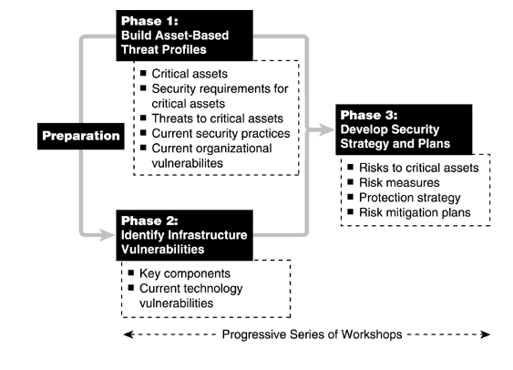

Slide 10
OCTAVE Phase - I
Build Asset-Based Threat Profiles
Critical assets
Security requirements for critical assets
Threats to critical assets
Current Security practices

Slide 11
OCTAVE Phase - II
Identify Infrastructure Vulnerabilities
Evaluation of the information infrastructure
Examine NW access levels and access mechanism
Assessing vulnerabilities associated with assets
Assess what type(s) of attacks can harm your critical assets
Identify the assets which are susceptible to these attacks

Slide 12
OCTAVE Phase - III
Develop Security Strategy and Plans
Risk to critical assets
Risk Measures
Protection strategy
Risk mitigation plans

Slide 13
Workshops
In applying the three phase approach, a progressive series of workshops are required within the organization. These workshops requires comprehensive interaction among the participants.
There are two types of workshops
Facilitated discussions with various members of organization
Activities conducted by the analysis team on its own
The team leader is responsible for
Guiding all workshop activities and ensuring timely completion.
Ensuring all participants understand their roles
Selecting a decision-making approach (e.g. consensus, majority vote) during the workshops
Every phases might have a different leader.
Person with strong communication and interview skills can lead the 1st phase
Person with strong planning and analysis skills can lead phase 3.

Slide 14
Octave Processes
Octave method is broken into eight processes. Four in phase 1, two in phase 2, two in phase 3.

Slide 15
Preparation
Getting Senior Management Sponsorship
Top success factor in IS risk evaluations
Selecting Analysis Team
The team should have necessary skills and training to lead evaluation
Setting Appropriate Scope
Selecting Participants
Mention important areas
Don’t call and engage who’s available, people should be part of analysis team and workshop due to their knowledge
If senior management does not support, staff support will dissipate quickly
They should know how to apply their knowledge when required
Scope should be limited initially but not to small

Slide 16
Phase 1: Build Asset Based Threat Profiles
In phase-1 you begin to build the organizational view of OCTAVE by focusing on the people in the organization .
1: Identify Senior Management knowledge
SM’s view of assets
2: Identify Operational Area management Knowledge
OA’s management view of assets
Areas of concern
Security Requirements
Current Security Practices
Current Organizational Vulnerabilities
Areas of concern
Security Requirements
Current Security Practices
Current Organizational Vulnerabilities

Slide 17
3: Identify Staff Knowledge
Staff’s view of assets
4: Create Threat Profile
Critical Assets
Areas of concern
Security Requirements
Current Security Practices
Current Organizational Vulnerabilities
Security Requirements for critical assets
Threats to critical Assets

Slide 18
Process 1-3
The analysis team facilitates knowledge oriented workshops during process 1-3
Participants from across the organization contribute their unique perspective about what is important to the organization (assets) and how well those assets are being protected
Senior managers are the audience in process 1, middle managers in 2 and technical staff in process 3.
So far four activities are undertaken
Identification of assets and relative priorities
Identify areas of concern
Identify security requirements for most important assets
Capture knowledge of current security practices and organizational vulnerabilities

Slide 19
Process 4: Create Threat Profile
Participants in this process are analysis team members. During process 4, the team identifies the assets that are most critical and describes how these assets are threatened.
Process 4 comprises of
Consolidating information from processes 1 to 3
Selecting critical assets
Refining security requirements for critical assets
Identifying threats to critical assets

Slide 20
Threat Profile
A threat profile is a structured way of presenting a range of threats to a critical asset.
In the OCTAVE Method, threats are represented in the profile using the following
Asset— something of value to the enterprise
Actor— who or what may violate the security requirements (confidentiality, integrity, availability) of an asset
Motive (or objective)— whether the actor's intentions are deliberate or accidental (applies only to human actors)
Access— how the asset will be accessed by the actor, e.g., network access, physical access (applies only to human actors)
Outcome— the immediate outcome (disclosure, modification, destruction, loss, interruption) of violating the security requirements of an asset

Slide 21
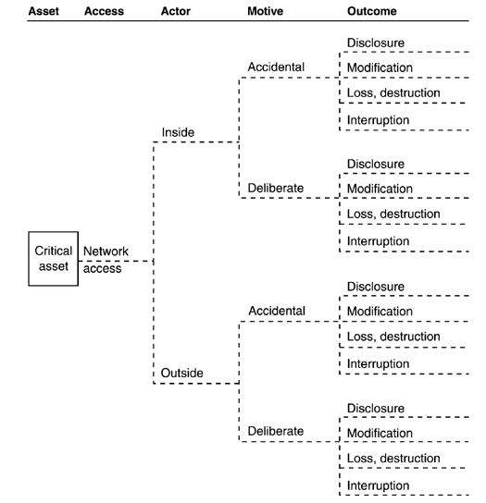
Asset-Based Threat Tree for Human Actors Using Network Access

Slide 22
Phase II: Identify Infrastructure Vulnerabilities
5. Identify Key Components
Upon completion of process 4 you identified your organization's critical assets and examined the threats to those assets. In process 5 you use this information to determine how to evaluate your organization's computing infrastructure for technology vulnerabilities
You need to focus on the vulnerability evaluation to complete it in an efficient and effective manner
It comprises of two activities
Identifying key classes of components
Identifying infrastructure components to be examined
To understand your risk, you need to collect vulnerability information only on key components relative to the critical assets. Process 5 enables you to identify those key components.

Slide 23
Technology Vulnerabilities
Ultimately, your goal during phase 2 of OCTAVE is to identify technological weaknesses in the computing infrastructure
Technology vulnerabilities are weaknesses in systems, devices, and components that can directly lead to unauthorized action
Technology vulnerabilities are present in and apply to network services, architecture, operating systems, and applications
Three types of vulnerabilities
Design Vulnerability
Implementation Vulnerability
Configuration Vulnerability

Slide 24
6. Evaluate Selected Components
Participants in this process are the analysis team and selected members of the IT staff
Ultimate objective of process 6 is to identify technological weaknesses in the infrastructure components that were identifies during process 5.
Running vulnerability analysis tools on selected infrastructure components
Reviewing technology vulnerabilities and summarizing results
It comprises of two activities

Slide 25
Phase III: Develop Security Strategy and Plans
This phase is designed to make sense of information you have gathered so far in the evaluation.
It is during this phase that you develop security strategies and plans designed to address your organization’s unique risks and issues
7. Conduct Risk Analysis
Participants in this process are the analysis team members
Goal of process 7 is to identify and analyze risks to the organization’s critical assets
It comprises of three activities
Identifying impact of threats to critical assets
Creating Risk evaluation criteria
Evaluating the impact of threats to critical assets

Slide 26
8. Develop Protection Strategy
The senior managers review and revise the strategy and plans as necessary and decide how to move on
In the second workshop, the analysis team presents the proposed protection strategy, mitigation plans, and action list to senior managers in the organization.
The goal of process 8 is to develop a protection strategy for the organization, mitigation plans for the risks to the critical assets and an action list of future actions.
Participants in first workshop for process 8 are the analysis team members and selected members of the organization (ISMF)
This process includes two workshops

